Slide 1
ENSE 374, Milestone 3
Snowbird
Li Pan,
Raymond Knorr,
Ali Rizvi,
Sana Khan,
Zain Abedin,
Priscilla Chua
Oct30/2018

Slide 2
Organization by Faculty
Each sub-faculty within engineering will have its own private site
In their site, by default, they will only see the content that is important to them
However, there would be an option to view an exhaustive list of all the specific content on a page from the whole engineering site
Ex: Forms

Slide 3
First Idea
Five main headings: Forms, Committee’s, Course Materials, Research Areas , and Documentation
A very wide and shallow tree, we decided that Forms could be lumped into one folder with other documentation

Slide 4
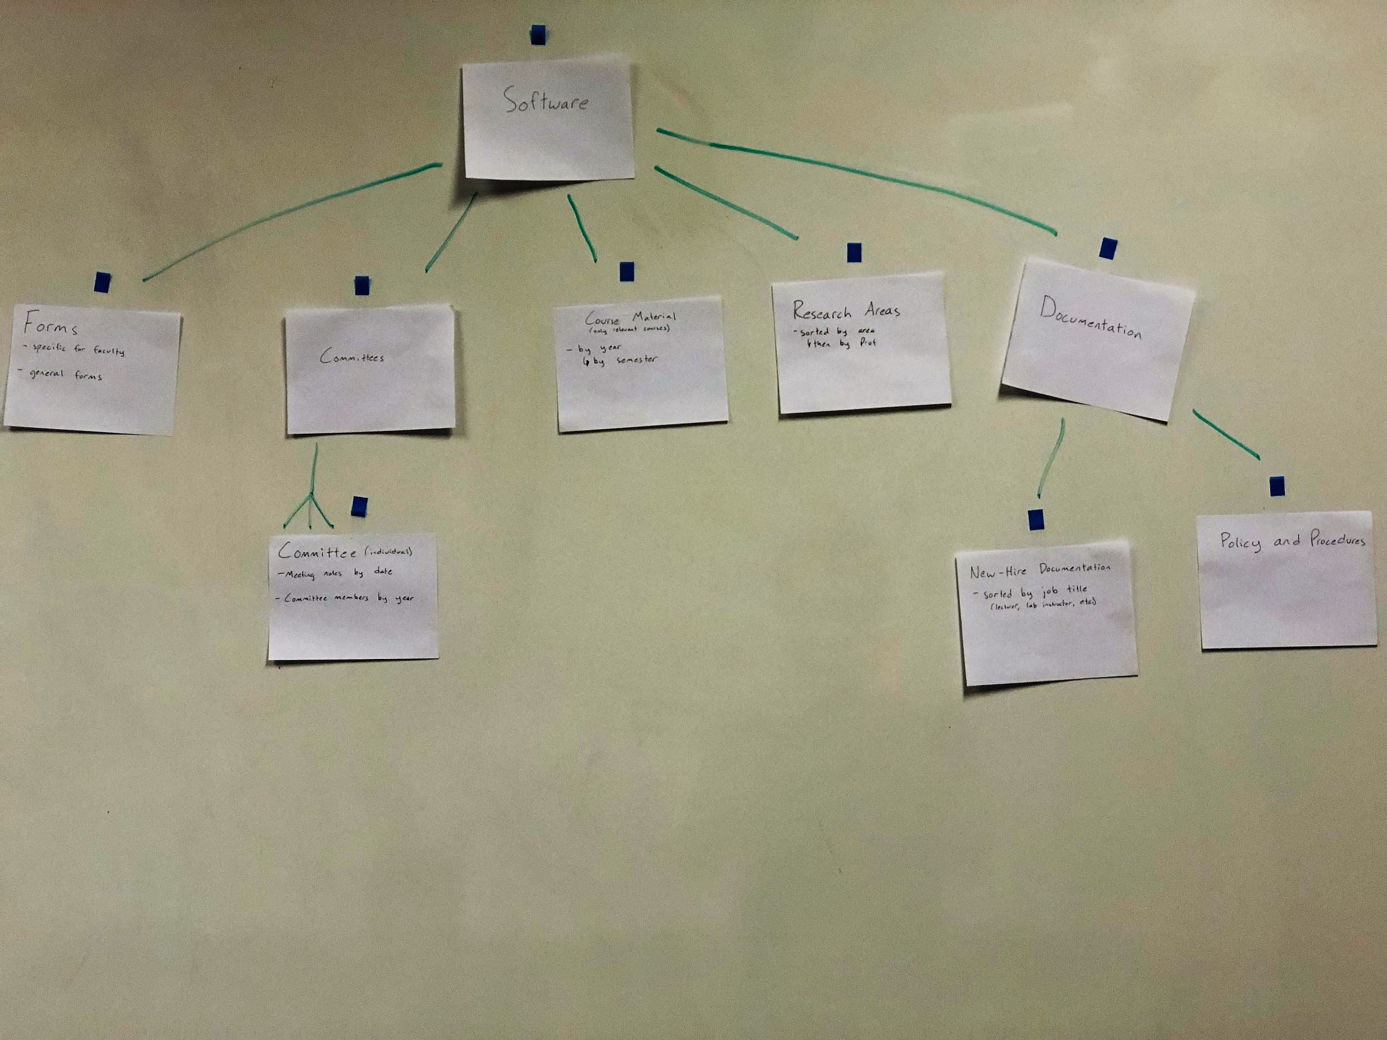

Slide 5
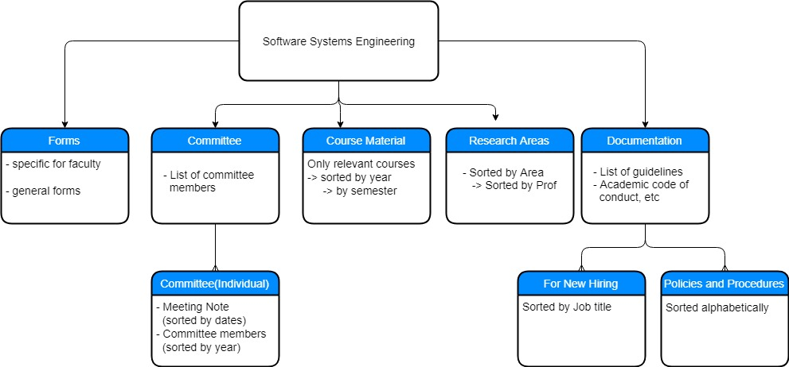

Slide 6
Final Idea
After some thought, we decided on four main headings: Committees, Course Material, Research Areas, and Forms/Documentation
Our choice of design could end up being pretty resource-intensive, especially on initial set-up, as each faculty would require a subset of the contents of the full engineering site
However, if the contents were successfully divided, the majority of regular users would likely have a much more efficient workflow

Slide 7
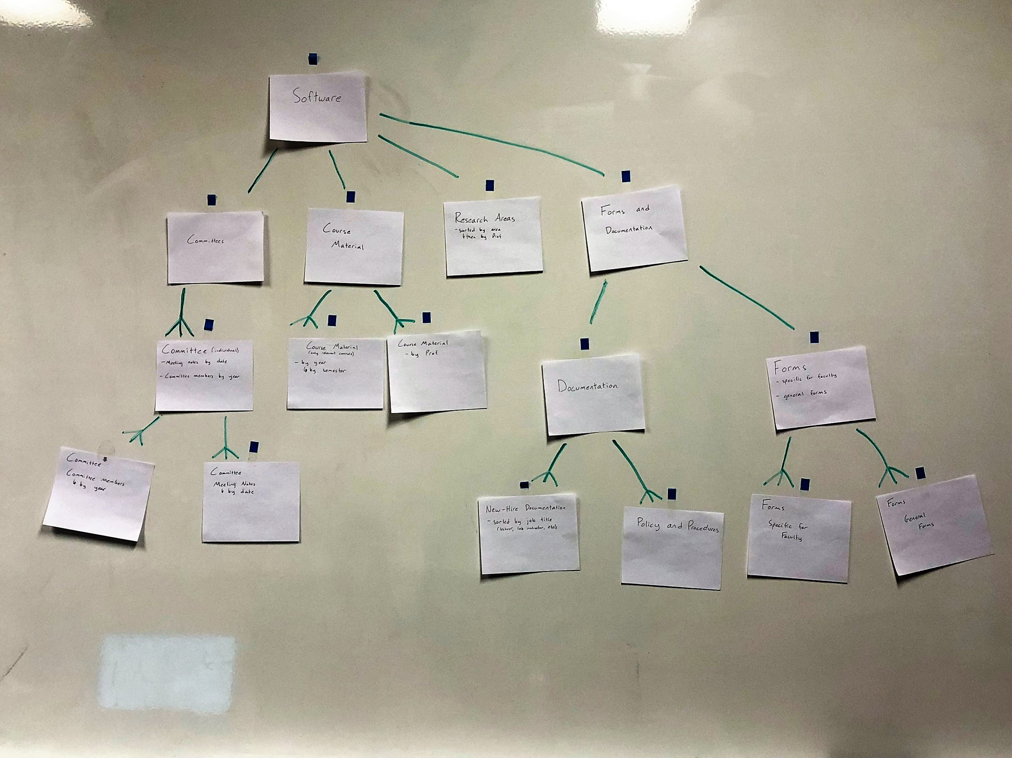

Slide 8
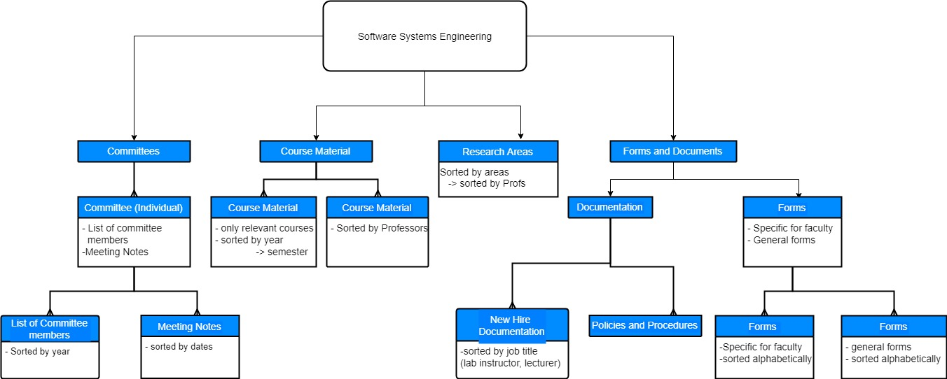

Slide 9
Workflow and Security/Privacy
The navigation tree is only three generations deep, with a main nav bar allowing for access to the main headings. This would allow for a relatively easy workflow, as everything on the site is a few clicks away
The security will be based primarily on faculty, where content will only be viewable by people in that faculty.
There could also be some sort of permissions system where individual users could have access to special pages, but we do not know how this fits in with the production of the private sites

Slide 10
Committee Section
There will be a list of all relevant committee’s, each of which will be divided into two sub-sections: Meeting Notes, and Lists of Members
Meeting Notes will display the notes taken at meetings, organized by date
Lists of Members will contain documents detailing the members and their positions on the committee, organized by year

Slide 11
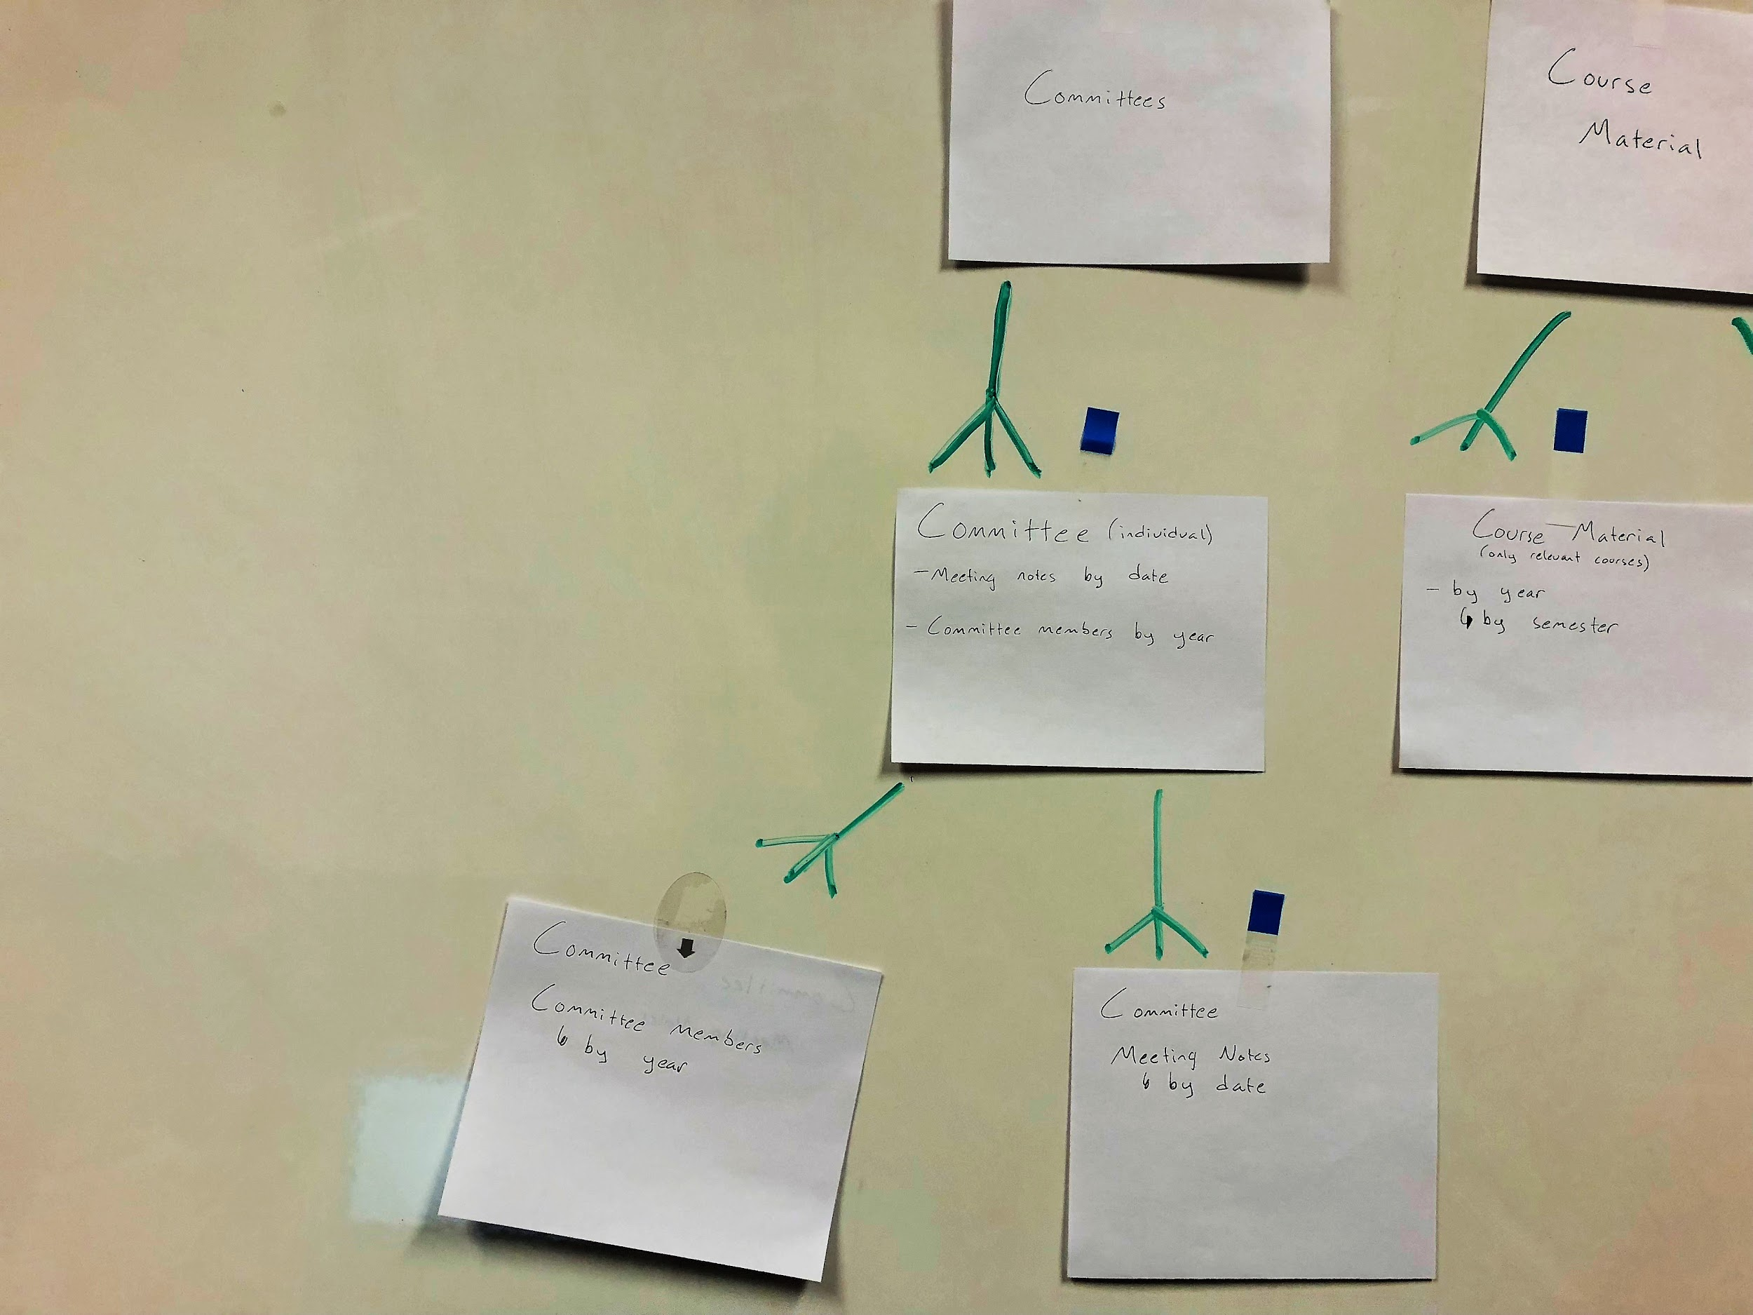

Slide 12
Course Material
Will be a list of courses that are offered in that faculty, with the option to sort them in two different ways
By course: after selecting a course, a user could select a year, and then a specific semester
By Professor: the user could select a professor and then see all of the courses that they have taught sorted by years

Slide 13
Research Areas
This section will just contain a list of research areas grouped by similarity
Within these sections, the research areas will be grouped by the professor
Again, by default, only the research areas most pertinent to the page’s faculty will be shown

Slide 14
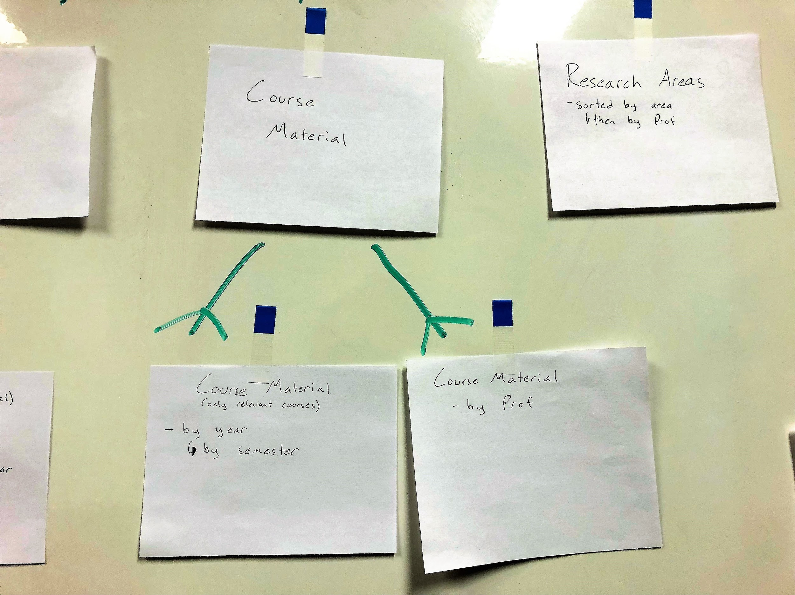

Slide 15
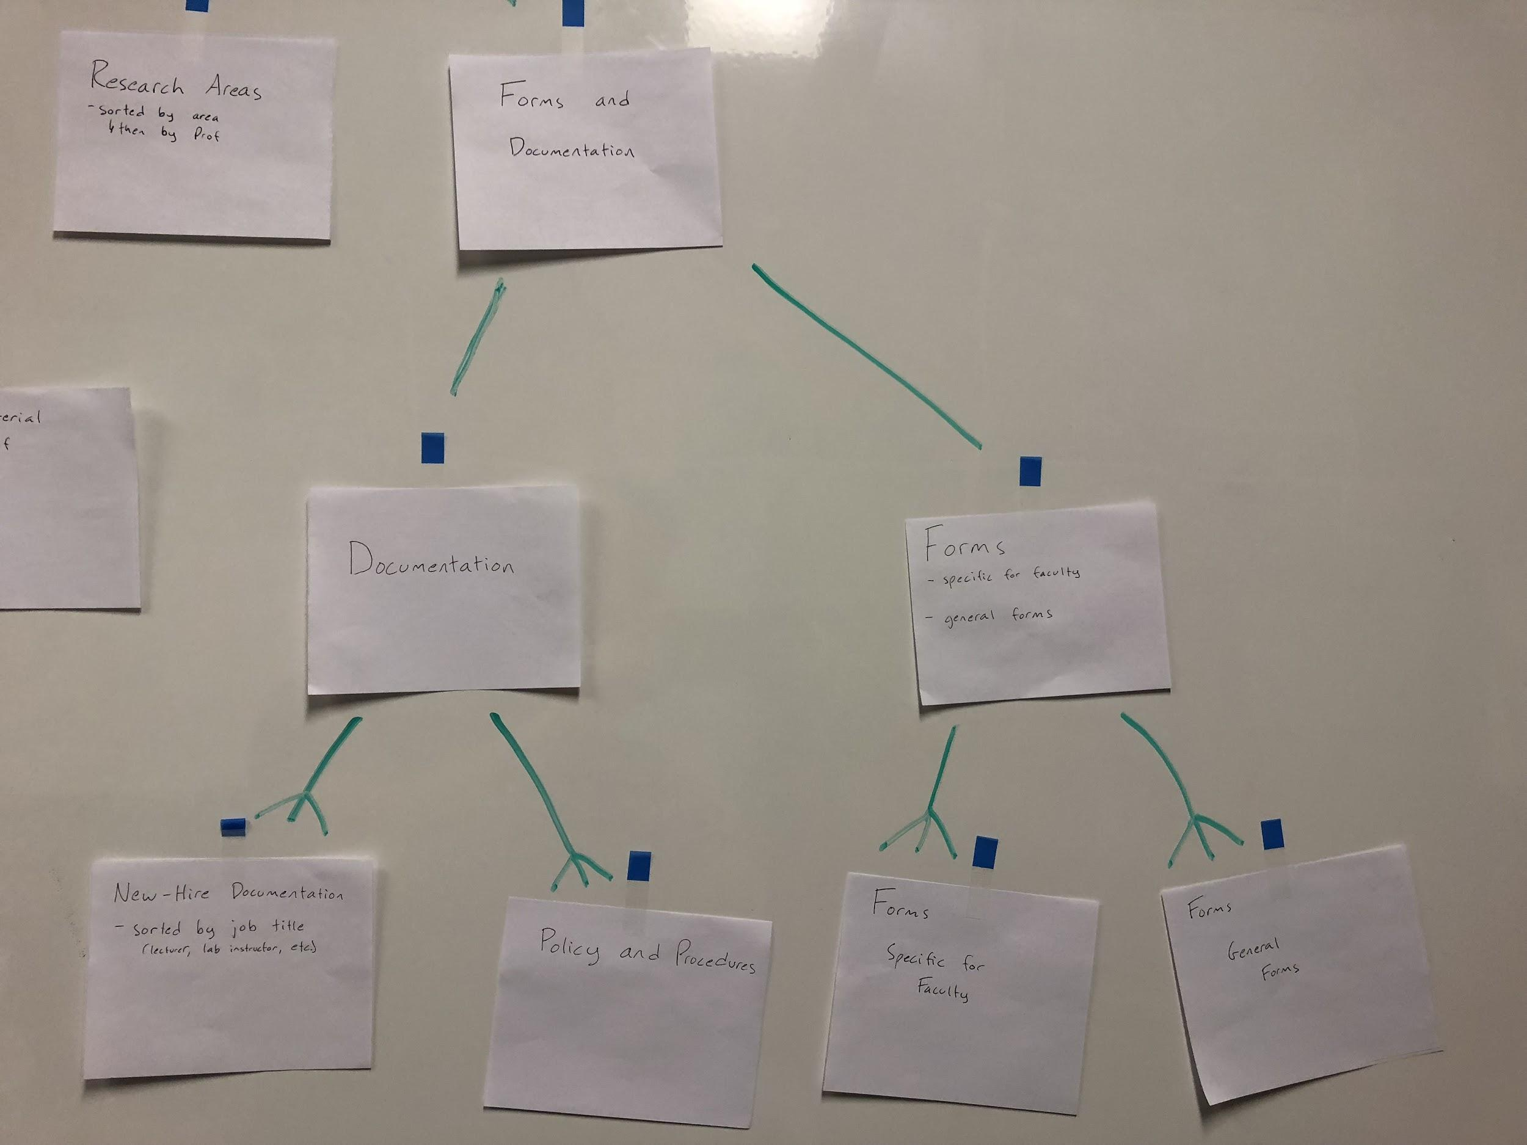

Slide 16
Documentation
Divided documentation into sections for New-Hire documentation and Policy and Procedures
New Hire Documentation:
Expectations and general info for a newly hired employee, selected by job title
Policy and Procedures:
Documents detailing lab policy, or academic misconduct, etc.

Slide 17
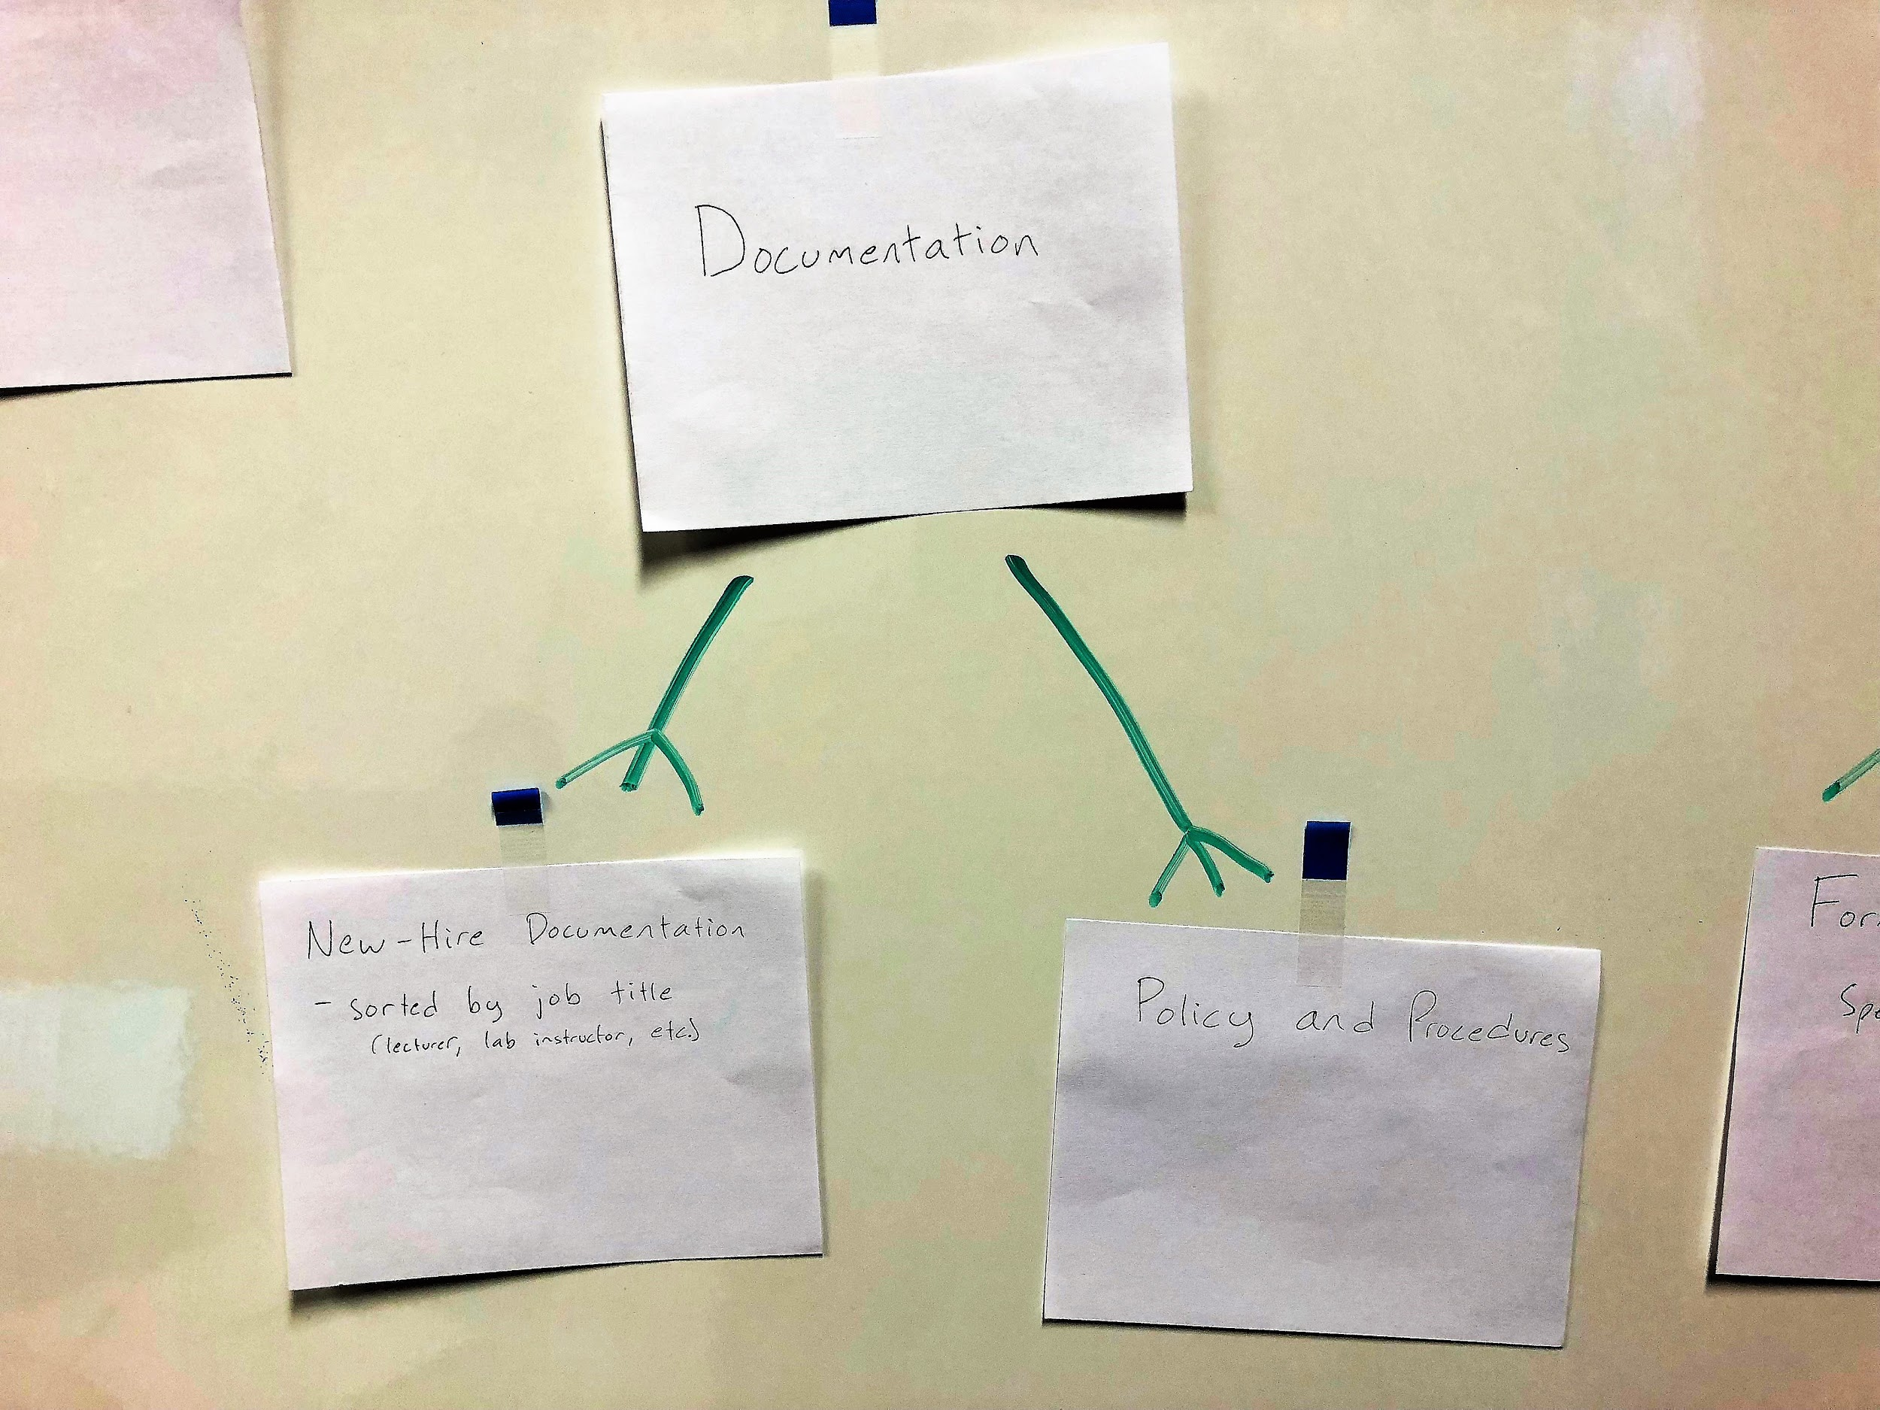

Slide 18
Forms
Forms divide into two parts: Faculty Specific Forms and General Forms
Faculty Specific Forms: Forms that focus on Software System Engineering
ex: Event Registration Forms for only software students
General Forms: Forms that can be used by all engineering site users
Office Laboratory & Key Card Access and Event Registration Forms
Forms were the main content that we proposed for removal from the public site
Forms should also follow a naming scheme, where only the most recent version of a form is kept on the site

Slide 19
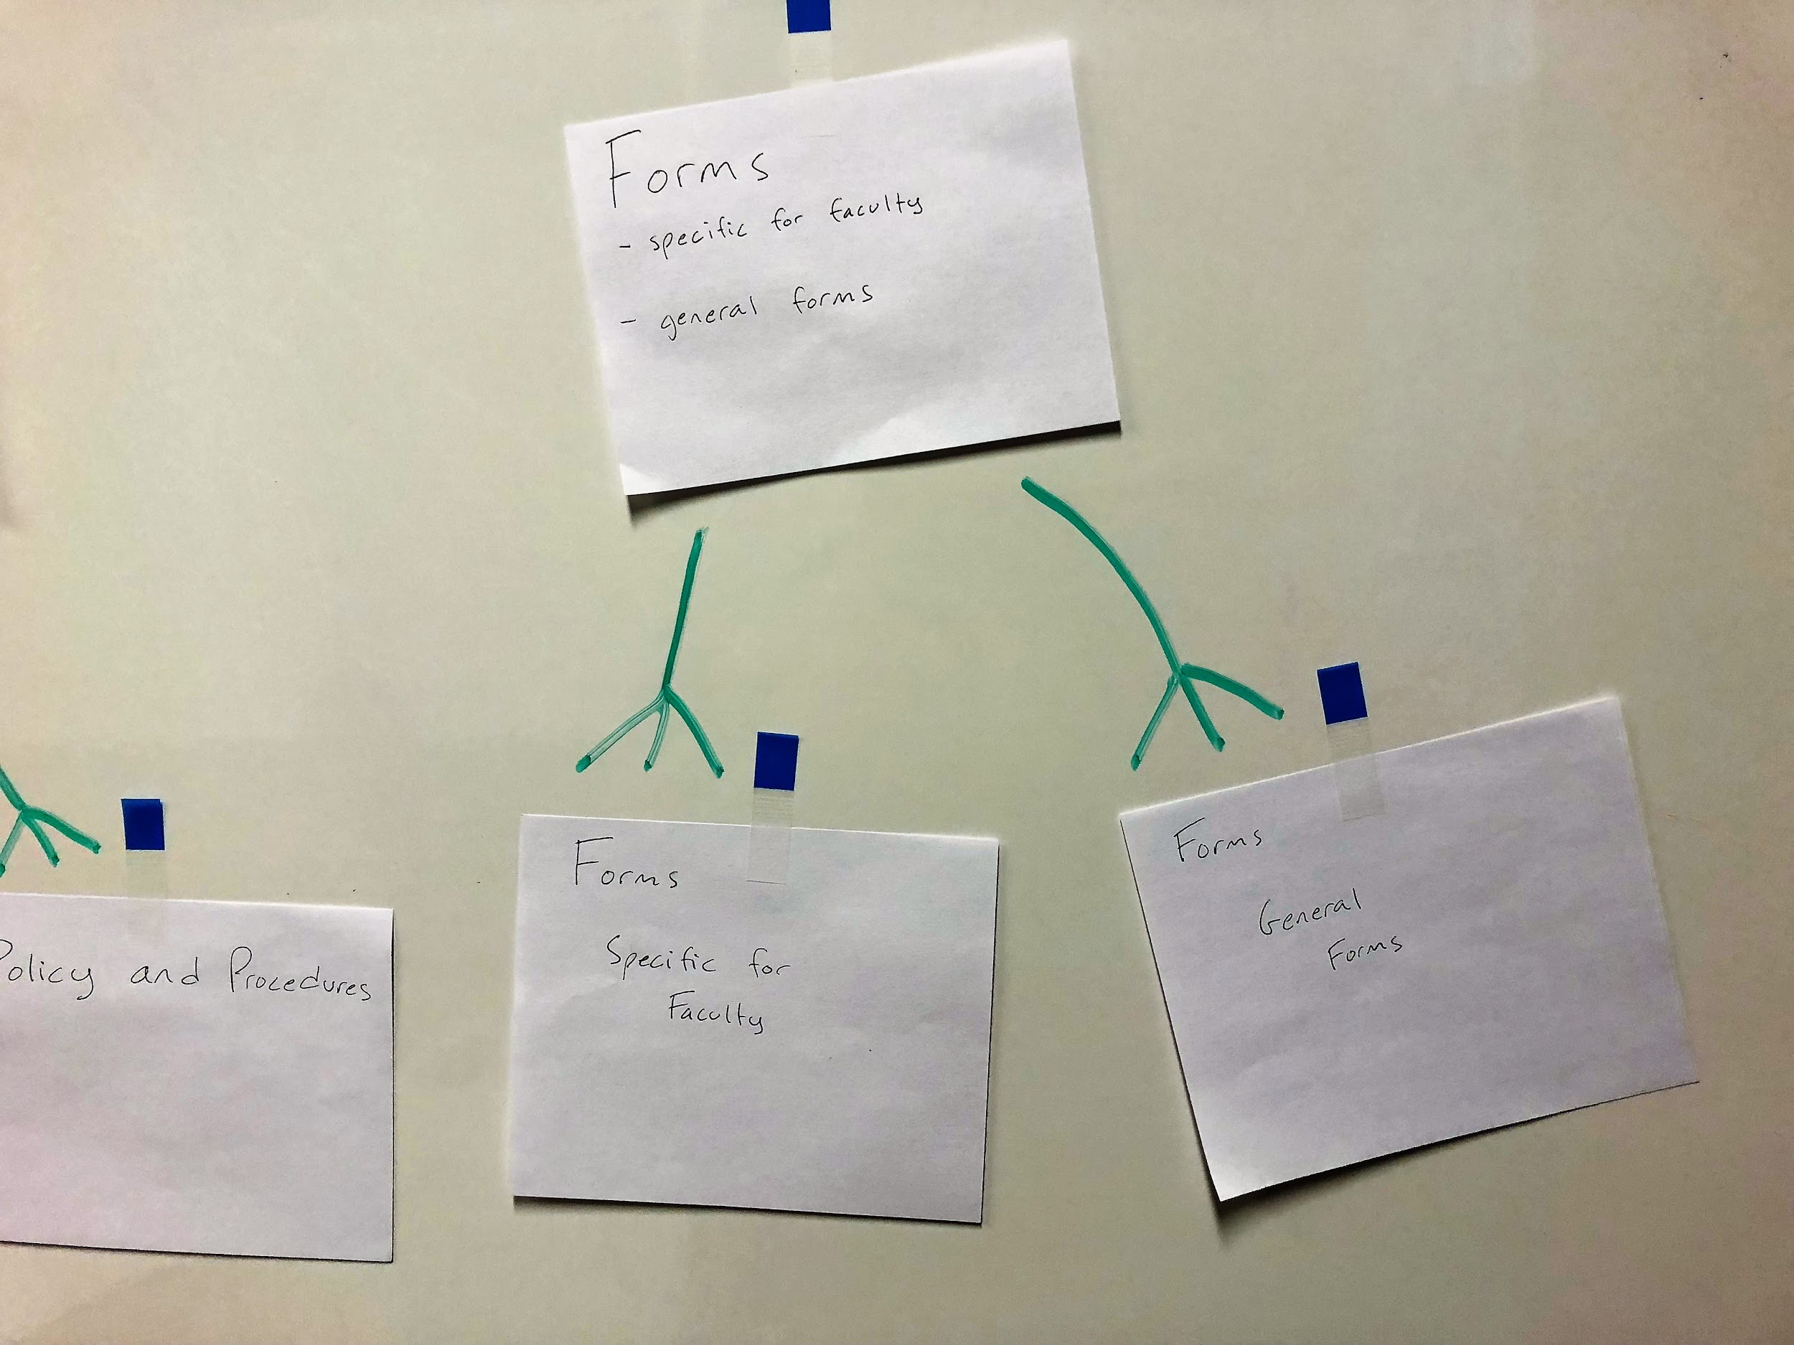

Slide 20
Group reflection
How did you feel about this milestone? What did you like about it? What did you dislike?
The binary tree like-graph used for the content model allowed us to easily collaborate our ideas. It also made it easier to make revisions to the model by just moving the sticky notes around. It would have been nice to see some of the data that was actually being modeled.
What did you learn about yourself as you collaborated and worked through this milestone?
Plan and brainstorm ideas before starting the work, so that the overall changes later on can be minimized.
How will you use what you have learned going forward?
Plan things out before actually executing the ideas behind them. Changes become more costly as the project progresses
What “stuff & things” related to this milestone would you want help with?
More clarification of expectations and content of the private site

